Slide 1
Learning Atari Game Strategies using Deep Reinforcement Learning
Supriya Kumari [1605411]
Rohit Kumar [1605045]

Slide 2
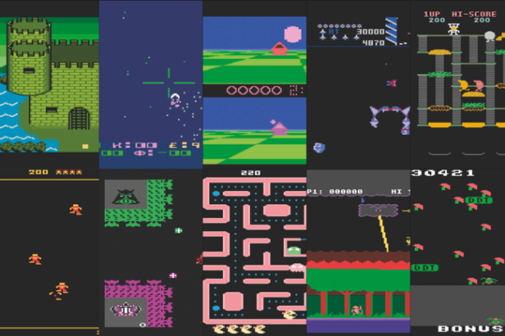
Problem Statement
Our aim is to create an AI agent which learns to play a number of Atari games using the same set of hyper parameters.

Slide 3
Industrial Use case
To Teach a robot to walk Train a car to navigate a steep hill

Slide 4
Industrial Use case
NVIDIA uses Rl to navigate a rover Robotic arm to reach target location

Slide 5
Industrial Use case
Training intelligent agents in rich and realistic environments

Slide 6
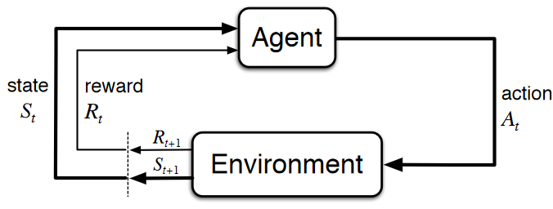
Brief Background of RL
Reinforcement learning develops control patterns by providing feedback on a model’s selected
actions, which encourages the model to select better actions in the future.
At each time step t
The agent:
• Executes action At
• Receives observation Ot
• Receives scalar reward Rt
The environment:
• Receives action At
• Emits observation Ot+1
• Emits scalar reward Rt+1

Slide 7
Brief Background
We broadly used two methods -
Q learning
Policy Gradients.
Q learning approximates the maximum expected return for performing an action at a given state using an action-value (Q) function.
Policy gradient methods rely upon optimizing parametrized policies with respect to the expected return (long-term cumulative reward) by gradient descent.

Slide 8
What We Tried?
We tested our algorithms on ’Pong’ - A two-dimensional game similar to table tennis.
Using the difference of two consecutive frames as states to capture the motion, our agent uses Policy gradients to learn an optimal policy by moving the policy in the gradient(direction) indicated by the rewards.

Slide 9
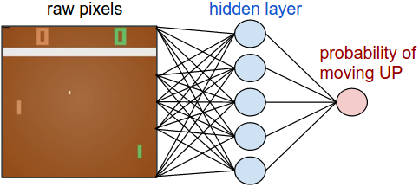
Image frame : 210x160x3 ( 100,800 sounds kind of impossible)
Action : move the paddle UP or DOWN (i.e. a binary choice).
Reward : +1 reward if ball hit, -1 reward if ball missed, or 0 otherwise.
Goal : To move the paddle so that we get maximum cumulative reward.

Slide 10
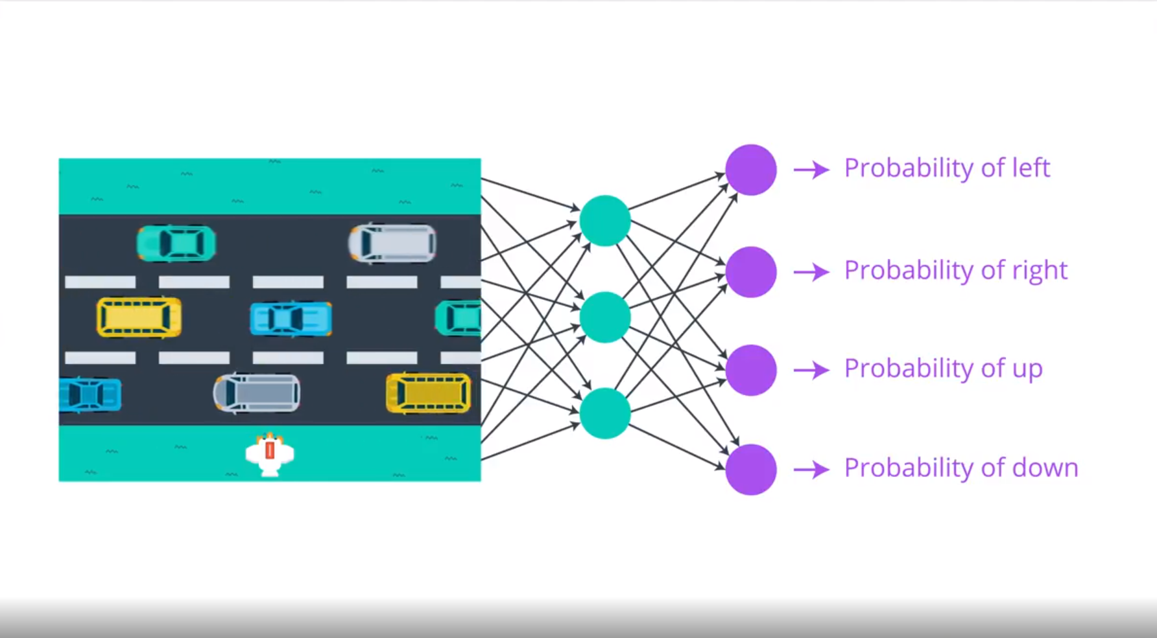
Training protocol
Notes:
Training protocol

Slide 11
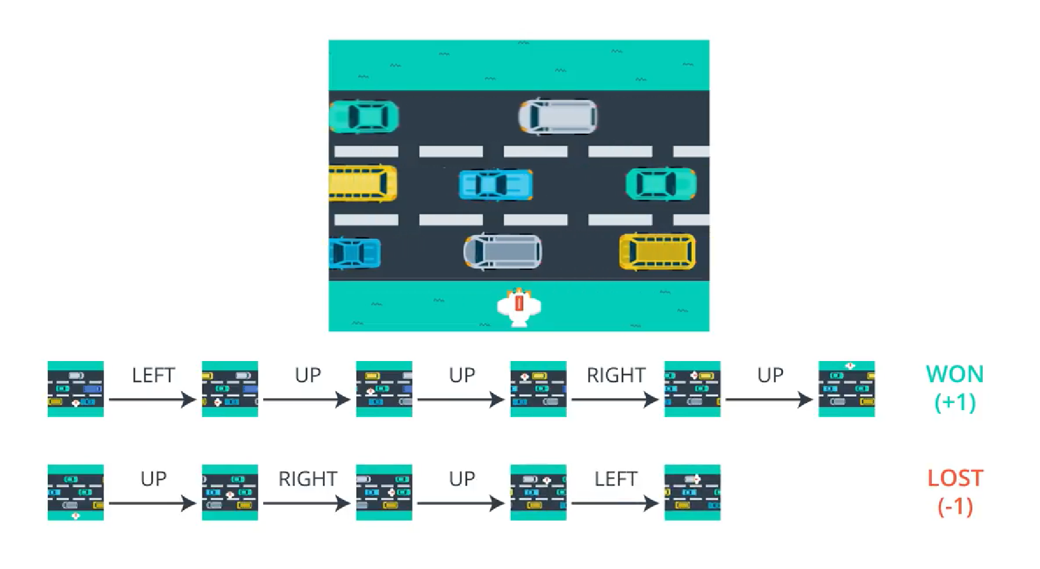
Training protocol
Notes:
Training protocol

Slide 12
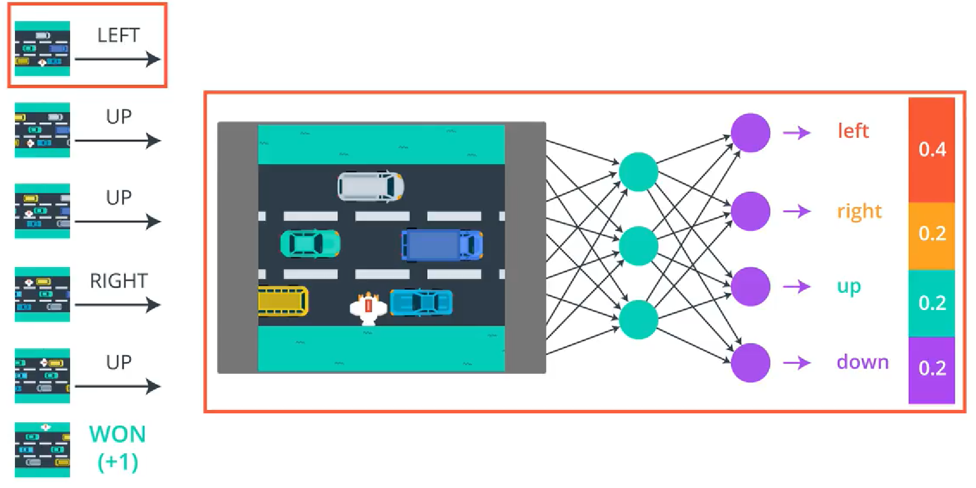
Training protocol
Notes:
Training protocol

Slide 13
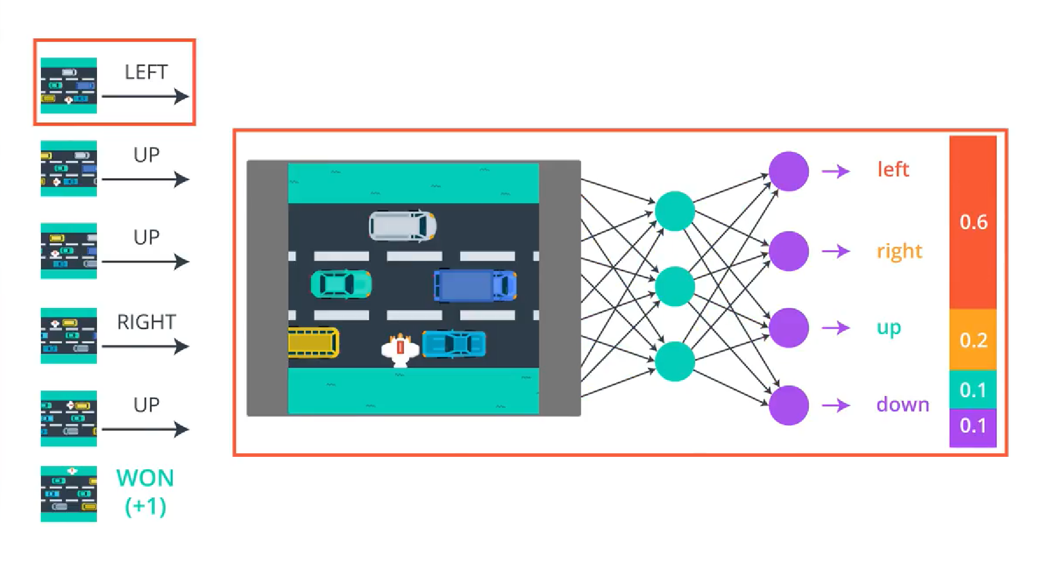
Training protocol
Notes:
Training protocol

Slide 14
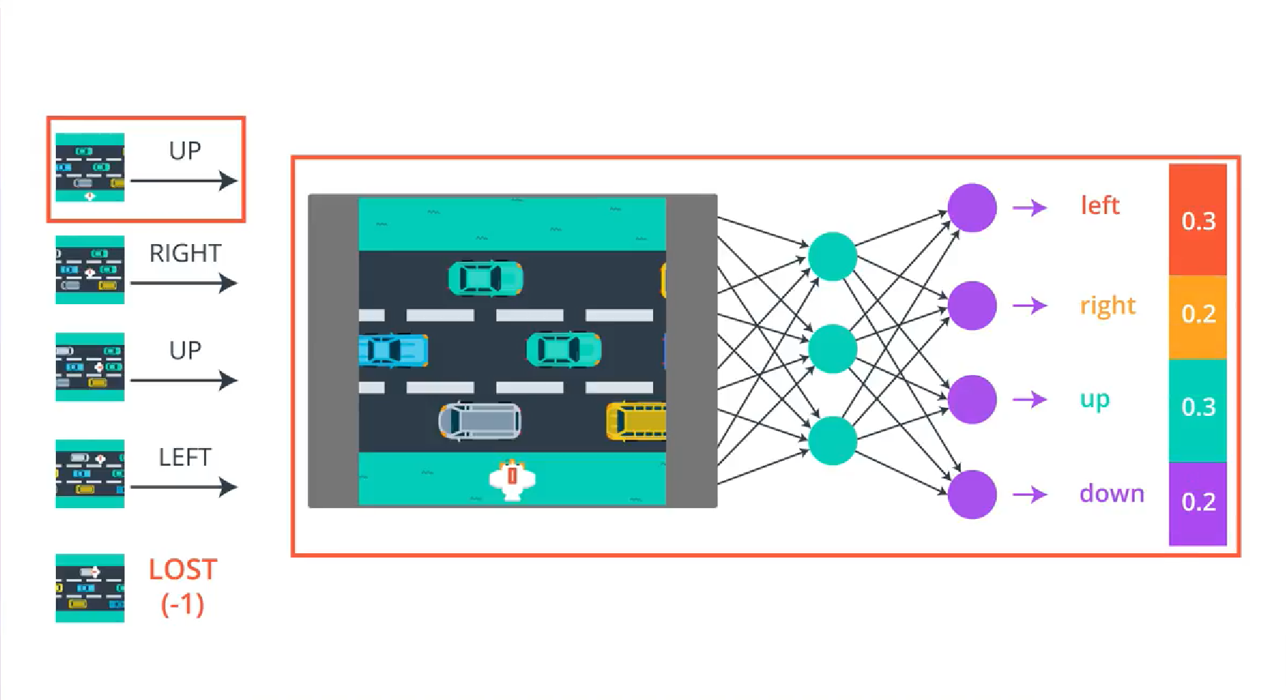
Training protocol
Notes:
Training protocol

Slide 15
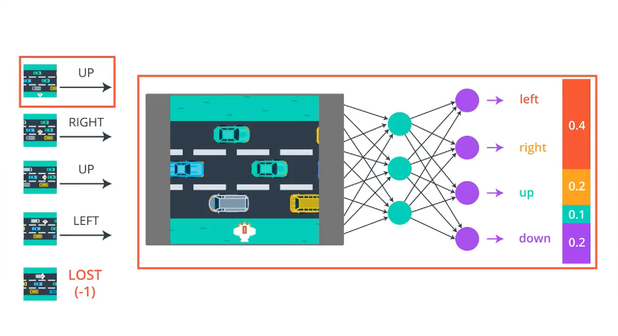
Training protocol
Notes:
Training protocol

Slide 16
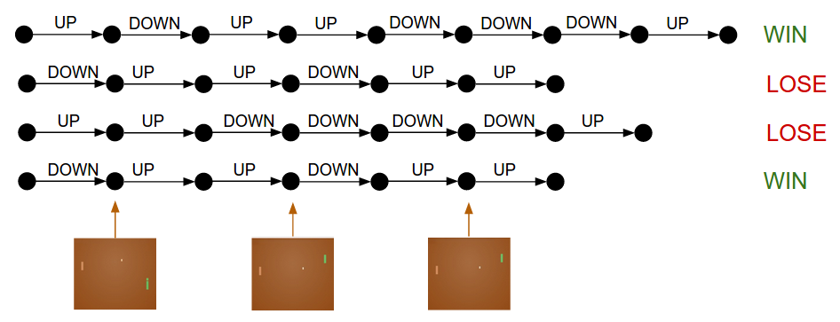
Episode

Slide 17
Training protocol
For Pong, We initialized the policy network with some W1, W2 and played 100 games of Pong.
Lets us assume that each game is made up of 200 frames.
So, in total we’ve made 20,000 decisions for going UP or DOWN
For example, Suppose Won 12 games and lost 88.
So,
200*12 = 2400 Decisions we made in the winning games and do a positive update.
200*88 = 17600 Decisions we made in the losing games and do a negative update.
The network will now become slightly more likely to repeat actions that worked, and slightly less likely to repeat actions that didn’t work.

Slide 18
Experimental Results Obtained
Our algorithm which used Policy Gradients reached a running average of -14 in 10,000 episodes of training. i.e.On average it was able to score 7-21 against its opponent.
Our agent went from an average score of -21 (equivalent to losing every game 0-21 to the AI) to -8 (losing 13-21 on an average), sometimes even thrashing the Pong AI.
Our Training is still underway.

Slide 19
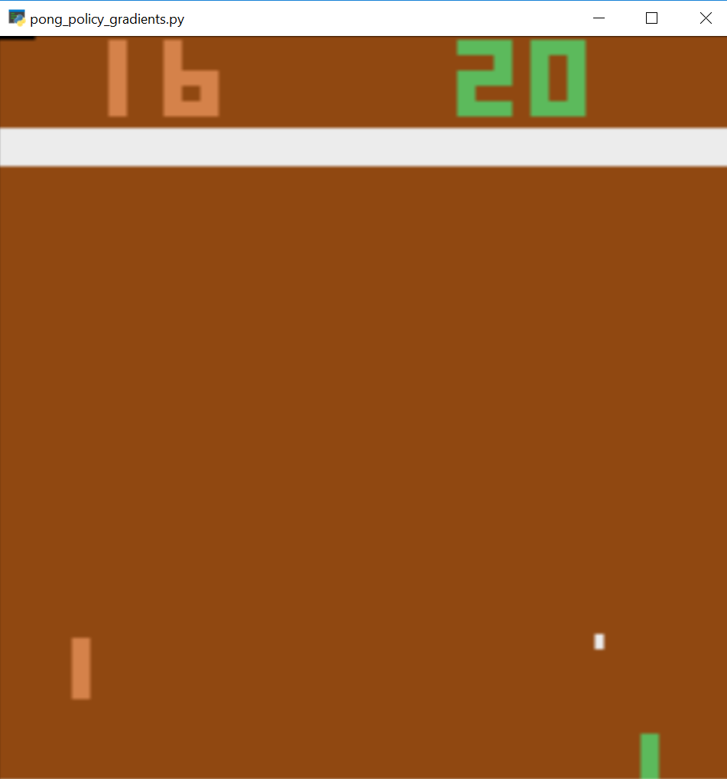
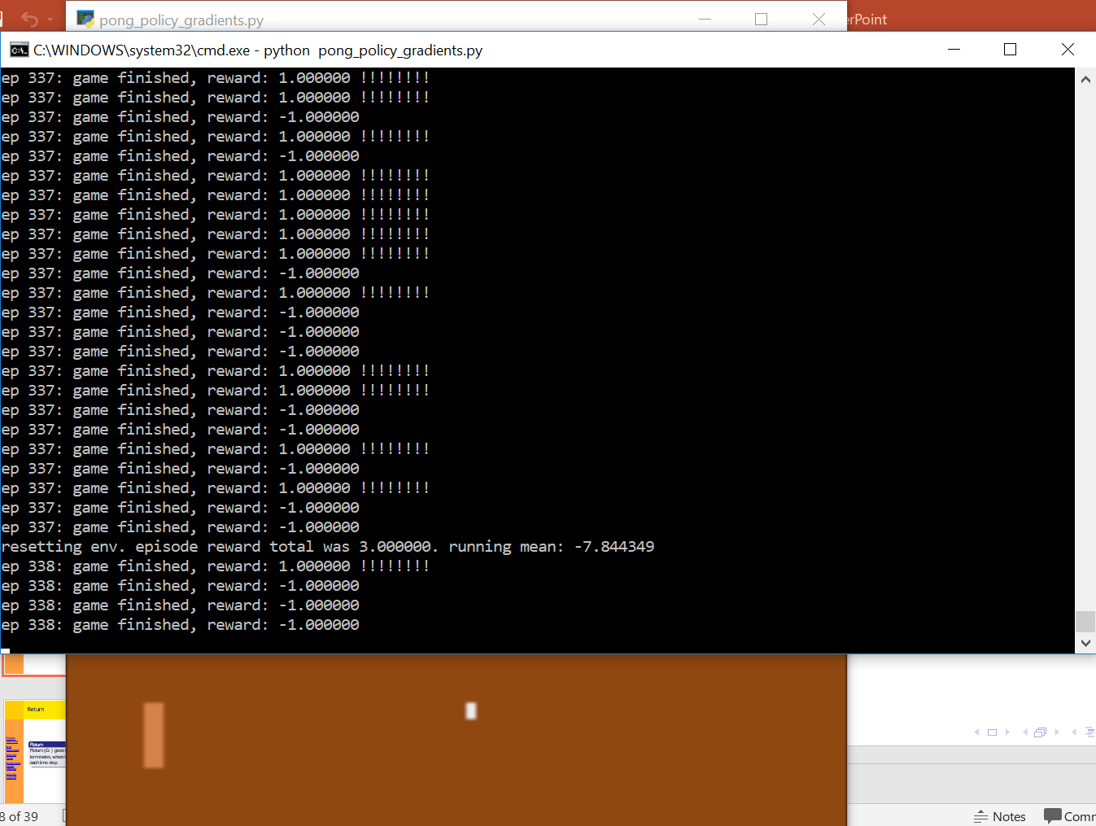

Slide 20
Things That We Learned
This project introduced us to a new paradigm in machine learning - Reinforcement Learning.
The following is a broad list of concepts and some tools that we learned:
• Basic terminology in reinforcement learning like rewards, history, environment, markov states, policy, value function, model and discount factor.
• Bellman Expectation and Optimality Equations for value function and action value function.
• Model Free Prediction - Monte Carlo Learning and Temporal-Difference Learning
• Policy Gradient Methods for RL
• Experience Replay
• Exploration and Exploitation
• Open AI gym

Slide 21
Demo a single game, Pong

